Slide 1
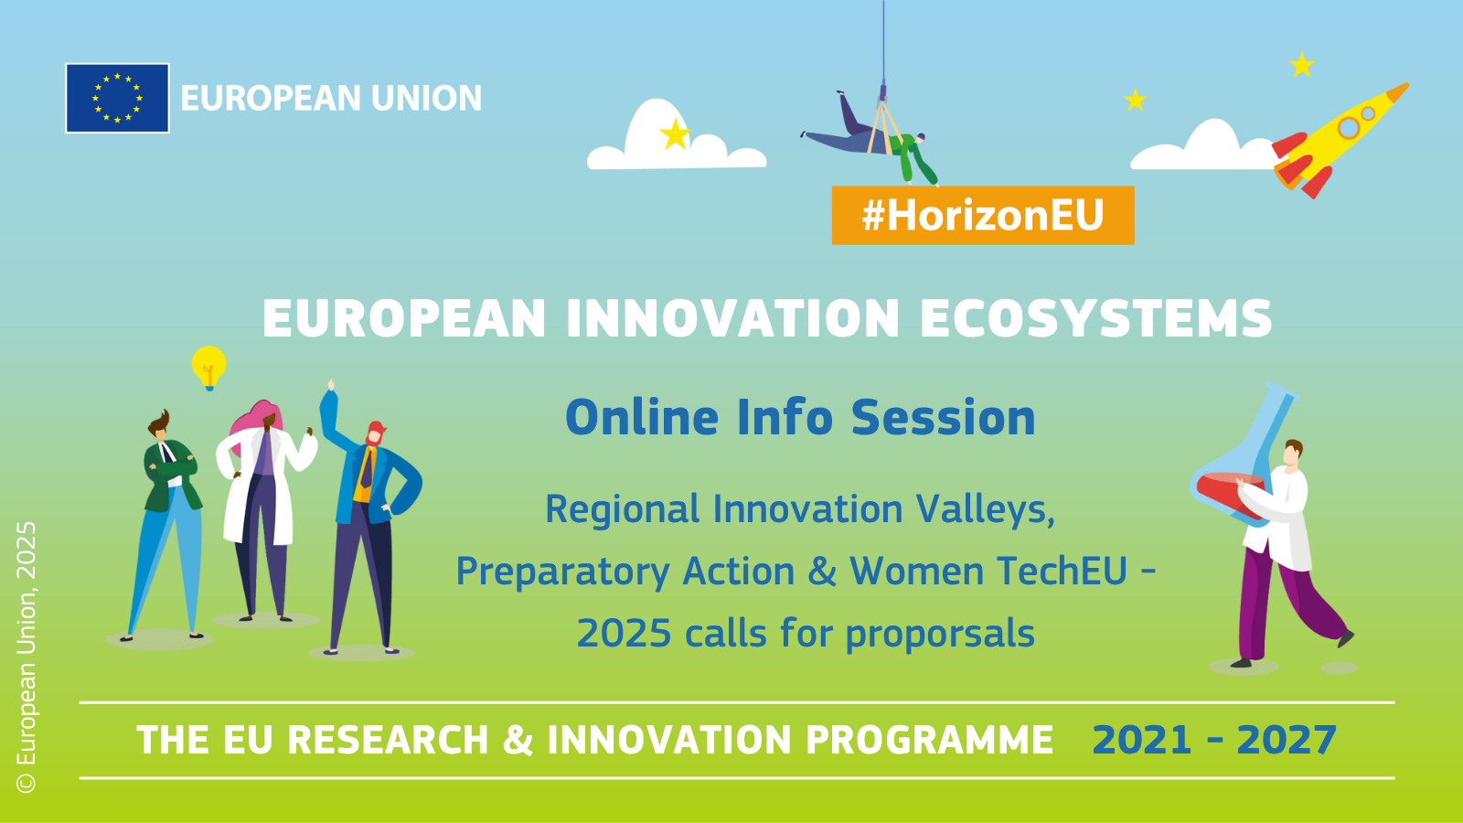

Slide 2
Daniel Gassmann
Moderated by
Head of Sector, EISMEA Unit I.1

Slide 3
10:00 Introduction and Opening
10:05 Part A: Regional Innovation Valleys (RIVs) calls – Policy context
10:15 The Regional Innovation Valleys calls under EIE WP and WIDERA WP
10:45 Q&A via Slido – RIVs
11:10 Preparatory action for setting up joint programmes among innovation ecosystems
11:20 Q&A via Slido – CSA
11:30 Part B: Women TechEU – Policy context and 2025 call
11:40 Q&A via Slido – Women TechEU
11:55 PIC registration and validation process
12:15 Closing remarks
agenda

Slide 4
Introduction
Gerald Cultot
Acting Head of Unit, EISMEA Unit I.1

Slide 5
Part A:
Regional Innovation Valleys (RIVs) calls – Policy context
Jekaterina Novikova
Deputy Head of Unit, DG RTD A5

Slide 6
Taking Startups Seriously
The Competitiveness compass - stronger EU value chains, territorial cohesion and closing the innovation gap
Startups and Scaleups Strategy (28/05/2025)
Innovation Act (Q1 2026)
28th regime (Q1 2026)
Expanded European Innovation Council
TechEU fund announced in the Competitiveness Compass

Slide 7
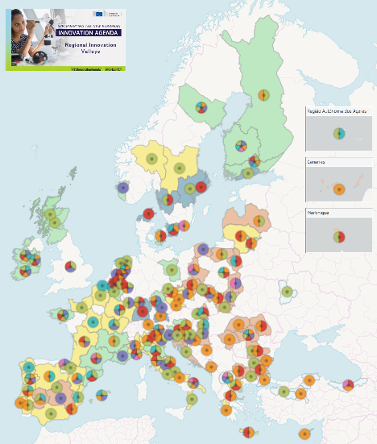
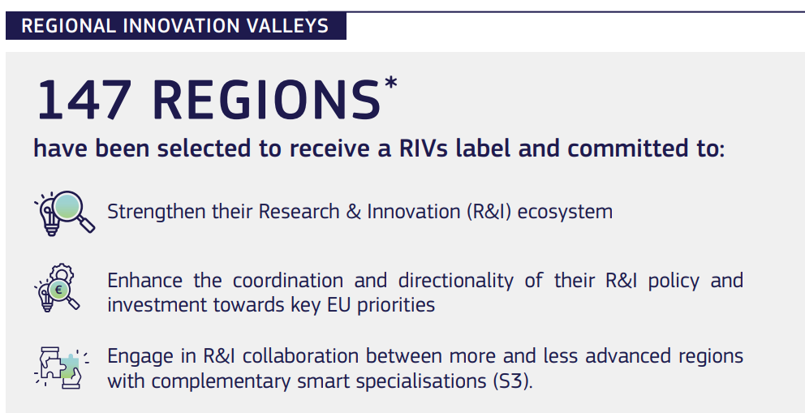
Selected Regional Innovation Valleys - European Commission (europa.eu)
Map of the regions

Slide 8
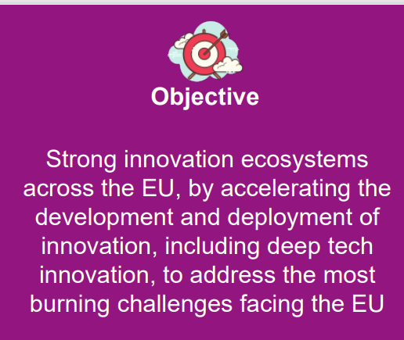
In a nutshell

Slide 9
In a nutshell
To create connected RIVs across EU
  involving regions with lower innovation performances
  building on strategic areas of regional strength and specialization
  supporting EU priorities / 5 burning challenges :
Reducing reliance on fossil fuels
Increasing global food security
Mastering the digital transformation (+ cybersecurity)
Improving healthcare
Achieving circularity

Slide 10

In a nutshell
RIV label
for successful applicants!
15 successful projects
5 EIE + 10 Interregional Innovation Investments Instrument (I3)
New calls in 2025

Slide 11
Regional Innovation Valleys
Directionality of R&I investments and policies
(common challenges)
Less and
more innovative regions
147 regions
Development and deployment of innovation
Deep tech innovation

Slide 12
Regional Innovation Valleys
Public authorities
Universities
RTOs
Industry, business associations, clusters,
SMEs, startups,
End-users, citizens
S3

Slide 13
RIVs related actions Horizon Europe
work programme 2025
Call HORIZON-EIE-2025-02: 15 May 2025 – 15 October 2025
🤝 Preparatory action for setting up joint programmes
📍 Implementing co-funded action plans for connected regional innovation valleys
WIDERA WP: RIVs “mirror” call (recorded info day of 20/05 available on YouTube)
Cluster 4 WP: System experimentation for Industry 5.0 (IA) (13/05)
Cluster 6 WP: Operationalisation of bioeconomy sustainability principles (info day 20/05)

Slide 14
Want to know more?
The online matchmaking interactive map update is live
EISMEA Info Day (online) – 3 June
Matchmaking event S3 CoP in Brussels (in person) - 18 June
S3 Conference 2025 | 18 June 2025 | Brussels, online - WestMED
The publication of lessons learnt “RIVs Gap Analysis” (soon online on our website)

Slide 15
Thank you!
Any questions?
New European Innovation Agenda roadmap (europa.eu)
Flagship 3: Accelerating and strengthening innovation in European Innovation Ecosystems
across the EU and addressing the innovation divide -
European Innovation Ecosystems (europa.eu)
Inforegio - S3 Community of Practice
Contact: RTD-REGIO-REGIONAL-INNOVATION-VALLEYS@ec.europa.eu
#Euinmyregion #EUinnovates #HorizonEU

Slide 16
Part A:
Regional Innovation Valleys (RIVs) calls – Policy context
Francesca Cervelli
Policy Officer, DG RTD A2

Slide 17
The Regional Innovation Valleys calls under EIE & WIDERA Work Programmes
Christina Nanou
Call Coordinator / Project Adviser, EISMEA Unit I.1

Slide 18
Call / topic information
Innovation Actions
Proposal templates
Regions search tools

Slide 19




Basic Info
Type of Action | COFUND (50% EU funding)
Call opening date: | 15 May 2025
Call closing date: | 15 October 2025
Time to inform the applicants (TTI): | end March 2026
Time to grant (TTG): | end June 2026
Total Indicative EU budget | 59 m € (35 m € EIE + 24 m € WIDERA)
Expected EU contribution / project | around 5-8 m €
Expected grants to be signed | ~10 (5-6 EIE + 4 WIDERA)
Estimated project duration | 3-5 years

Slide 20
Who can apply?
Regional and/or national authorities (min eligibility requirement)
[shape innovation policies/programmes and able to provide 50% co-funding]
Other Q-helix actors (academia, SMEs/startups, clusters, end-users, etc.):
as beneficiaries (able to provide 50% co-funding) - for HE eligible countries
as associated partners - for HE non-eligible countries

Slide 21
Eligibility conditions ? EIE WP
Consortium requirements:
Regional innovation status:
Budget:
Letter of Intent :
Communication Networks:
Ineligibility of Identical Proposals:
at least 3 national/regional authorities from
at least 3 different Member States or Associated Countries
from which
at least 1 from 'moderate' or 'emerging' innovator region
at least 1 from a 'strong' or 'innovation leader' innovator region
at least 50% of total eligible costs to FSTP and/or PCP/PPI
a single letter of intent indicating the source of the 50% funding
restrictions for the protection of European communication networks.
identical proposals under the mirror WIDERA call are not eligible.
FSTP: Financial Support to Third Parties
PCP: Pre-commercial procurement, PPI: Public procurement for innovative solutions

Slide 22
Eligibility conditions ? WIDERA WP
at least 3 national/regional authorities from
at least 3 different Member States or Associated Countries
Minimum consortium requirements:
Regional representation:
Widening country requirement:
Widening coordinator location:
Widening financial allocation:
Financial Allocation:
Letter of Intent Requirement:
Communication Networks:
from which
at least 1 from 'moderate' or 'emerging' innovator region
at least 1 from a 'strong' or 'innovation leader' innovator region
at least 2 from a widening country
at least 1 from a non-widening country
Coordination established in a widening country
major budget share allocated to widening countries’ participants
at least 50% of total eligible costs to FSTP and/or PCP/PPI
a single letter of intent indicating the source of the 50% funding
Restrictions for the protection of European communication networks

Slide 23





Scope
Inter-regional collaboration networks to foster innovation
Strategic-oriented joint programme of activities (Annual work programmes)
Public authorities (national/regional) + private and R&I actors implement joint activities towards innovation deployment / development to tackle challenges at EU, national, regional and local level.

Slide 24
Expected outcomes
Regional Innovation Valleys
Excellent hubs
Digital Innovation Hubs
Enterprise Europe Network
Climate-Neutral and Smart Cities Mission
Circular Cities and Regions Initiative
Hubs for Circularity
Hydrogen Valleys
Renewable Energy Valleys
Industry 5.0 System Innovation Hubs
Open, inclusive, interconnected innovation ecosystems, joint definition of visions/strategies
Common knowledge assets
/ resources / expertise;
Synergies / complementarities /collaboration thematic/tech areas of joint/EU interest;
Increased innovation capabilities; ideas into the market
Better links of territories and innovation actors
More innovation co-investments (COFUND).

Slide 25
In the proposal
“What is the challenge you want to tackle and why this matters for Europe”?
Which are the joint strategic visions / commitment / agreed innovation action plans?
Key Performance Indicators (KPIs)? Joint commitment (LoI)?
Why this specific thematic/technological area of cooperation
What activities / process / R&I assets are mobilised?
How you ensure private actors’ participation and synergies with funds/policies/programmes ?
How you improve efficiency / performance of EU innovation ecosystems?

Slide 26
In the proposal
Which are the needs / reasons for the proposed Action plan
(Annual Work Programmes)?
1.
capacity building activities
2.
setting common strategy, joint action plans
3.
concrete joint horizontal activities
(including staff exchange, visits, etc.);
4.
concrete joint innovation actions
(joint funding calls)
C l e a r s t e p s:

Slide 27




Proposals should include an ACTION PLAN
Coordination & Support
Innovation Actions
Innovation projects / joint open calls (FSTP)
and/or
Pre-commercial procurement (PCP) or
Public Procurement for Innovative solutions (PPI)
Core collatoration activities
Access to new markets/finance
Activities to scaleup of innovative solutions
Training and skills development
Open-innovation infrastructures
Support procurers of innovative solutions
Include social innovators, civil society
+
Joint innovation agendas
Concrete outcomes

Slide 28
Example: budget / actions
Total project budget = EUR 10 million (50% EU contribution)
Coordination & support
Innovation Actions
(*at least 50% of the total eligible costs)
Core collaboration activities
EUR 2 million
(20% of total budget)
+
Innovation projects
Joint open calls (FSTP)
EUR 6 million
(60% of total budget)
Pre-commercial
procurement (PCP)
EUR 2 million
(20% of total budget)
+
Budget category « FSTP »
Budget category « subcontracting »

Slide 29






Innovation Actions
Joint open calls (FSTP)
HOW MANY? At least 3 interregional projects in specific thematic area(s)
WHAT FORM? Grants
WHAT? Innovation Actions (IA) – TRL 6-8
WHO? Research & Innovation actors from participating regions
HOW MUCH? Max EUR 600 k (per recipient for all calls/sub-projects)
May involve PCP/PPI activities
Sub-project 1
EUR 2 m
Sub-project 2
EUR 2 m
Sub-project 3
EUR 2 m
X
A
B
X
D
E
G
H
I
C
F
X

Slide 30
Maturity of innovation (TRL levels)
Innovation Actions
Joint interregional projects (FSTP) → TRL 6-8
Pre-commercial procurement (PCP) → up to TRL 8
Public Procurement for Innovative Solutions (PPI) → up to TRL 8*
Technology development & demonstration
TRL 6 – technology demonstrated in relevant environment
TRL 7 – system prototype demonstration in operational environment
Business & Investment Development
TRL 8 – system complete and qualified
TRL 9 – actual system proven in operational environment
Ref: HE General Annexes (Annex B)

Slide 31
Rules & Legal base for Financial Support to third parties (FSTP)
    No specific call requirements (apart from max EUR 600 000 per third party)
    Beneficiaries responsible to set call conditions
    🚩 FSTP annex to be filled in the proposal (Part B)
    Legal base:
    Financial Regulation - Art 207 (2024/2509 - 23 Sept 2024) – new!
    General Annexes to the Horizon Europe WP 2023-2024 (B. Eligibility)
    Horizon Europe Model Grand Agreement (Art.6.2.D.1 & Art 9.4 )
    General Block Exception Regulation (GBER)

Slide 32
Rules & Legal base for Financial Support to third parties (FSTP)
    Horizon Europe Model Grand Agreement - (Art.6.2.D.1)
    The proposal must include the implementation conditions of the support and ensure objective and transparent selection procedures and include at least the following elements:
      the maximum amount to be granted to each third party (max EUR 600,000)
      the criteria for calculating the exact amount
      a closed list of the different types of activities that qualify for financial support
      the persons or categories of persons that may receive support
      the criteria for giving financial support
      the measures to avoid potential conflicts of interest or unequal treatment of applicants
    Horizon Europe Model Grand Agreement - (Art.6.2.D.1)
    General Annexes to the Horizon Europe WP 2025 (B. Eligibility)
    Applicants must clearly describe the objectives and the expected results incl. the elements listed in the application template.
    The following conditions must also be fulfilled:
      calls to be published widely and to adhere to EU standards of transparency, equal treatment, conflict of interest and confidentiality
      calls must be published on the F&T Portal and on the beneficiaries’ websites
      calls must remain open for at least 2 months;
      if submission deadlines are changed, this must immediately be announced and registered applicants must be informed of the change
      projects must publish the outcome of the calls without delay – incl. description of projects, date of the award, duration, the legal name & country
      the calls must have a clear European dimension
The beneficiaries must ensure that:
their contractual obligations under Articles 12 (conflict of interest), 13 (confidentiality and security), 14 (ethics), 17.2 (visibility), 18 (specific rules for carrying out action), 19 (information) and 20 (record-keeping) also apply to the third parties receiving the support (recipients)
the bodies mentioned in Article 25 (e.g. granting authority, OLAF, Court of Auditors (ECA), etc.) can exercise their rights also towards the recipients.

Slide 33
Proposal templates
  Applicants should submit:
  Part A - Forms & budget
  Part B - Technical info (main proposal – max 70 pages for COFUND)
  Annexes:
  Annual Work programme (1st year of project)
  Financial Support to Third Parties (FSTP)
  Letter of intent (mandatory – eligibility condition)
  Additional information – beneficiaries (xls. file)

Slide 34
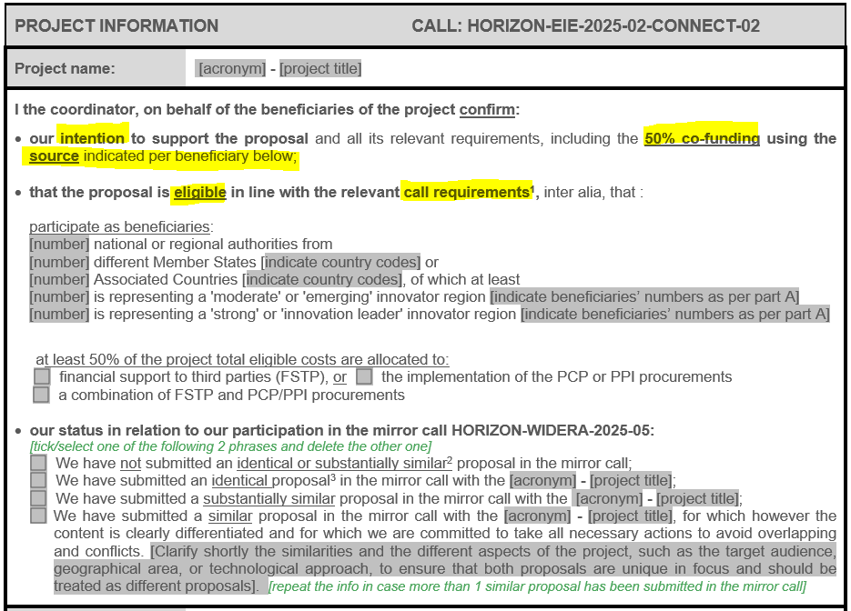
Proposal templates – Annex: Letter of intent (LoI)
  MANDATORY - filled in and duly signed and dated by coordinator on behalf of beneficiaries

Slide 35
Proposal templates – Annex: Additional info (xls file)
Reduce reliance on fossil fuels
Increasing global food security
Mastering the Digital transformation
Improving healthcare
Achieving circularity
Regional funding
National funding
EU funding – ERDF
EU funding – other
Private funding
EIE WP
I3 instrument
Call for Expression of Interest (CEI)
NO

Slide 36



Can I submit a proposal in both mirror calls EIE/WIDERA RIVs call?
An identical proposal
submitted in the mirror call
A substantially similar proposal submitted in mirror call
(significant overlaps in content/partners/objectives …)
A similar proposal
submitted in mirror call, with
clearly differentiated content
EIE proposal : Ineligible
May be asked to withdrawn one
Both to be evaluated,
but not ideal…

Slide 37
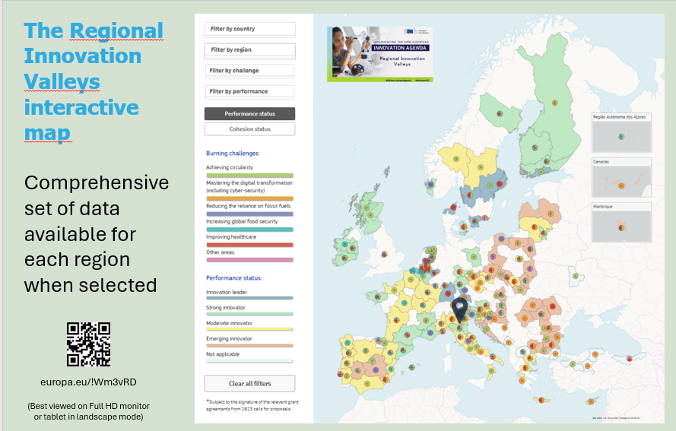
How to find partner regions?
(1) Check selected Regional Innovation Valleys (2023 call)
RIVs Virtual Map of successful regions engaged in the initiative

Slide 38
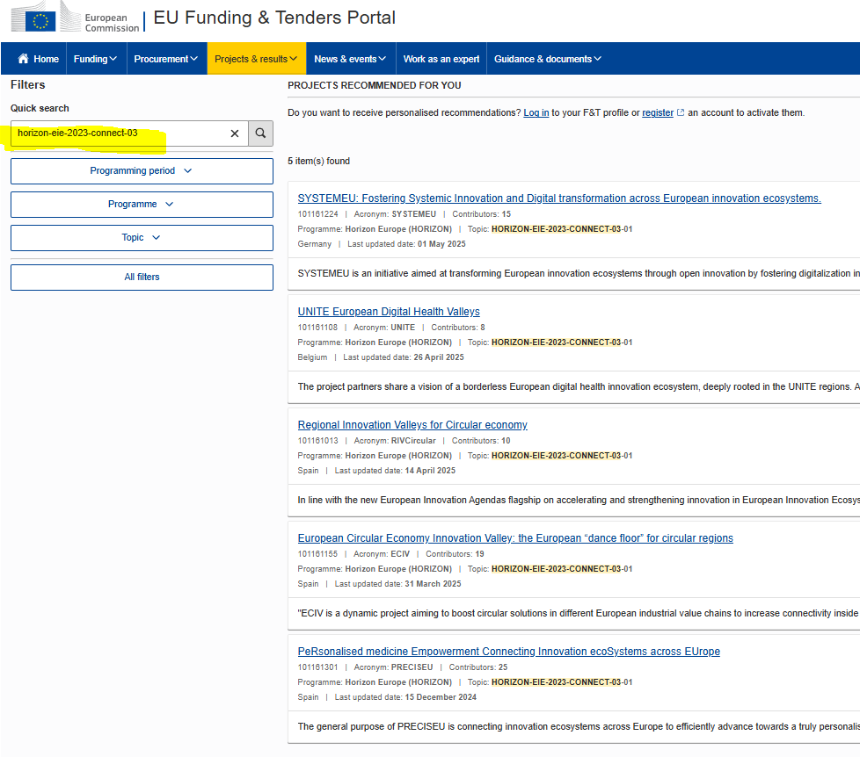
How to find partner regions?
(2) Check ongoing RIV PROJECTS – call HORIZON-EIE-2023-CONNECT-03
Learn about ongoing RIV projects
European Green Week
4 June 2025 (14:00 – 17:30h)
ECIV project event (HYBRID)
Register here:
https://www.navarra.es/es/web/forms/shared/-/form/4545

Slide 39

In one slide
Start early!
Check eligibility conditions!
Submit on time!
Build strong proposals!
European Innovation Ecosystems (EIE WP) – p. 17/44 & Call / submission in Portal
Widening participation & strengthening ERA (WIDERA WP) – p. 32 / 74 & Call / submission in Portal
Horizon Europe General Annexes 2025
Check Q&A in the Funding & Tenders Portal
Consider the recent policy developments (Startup Scaleup Strategy etc.)
Select partners smartly & involve existing networks
Check legal base for FSTP calls (Annex)
Reply to all fields of the proposal template and introduce realistic KPIs
Ensure coherence between Part A budget table and Part B (avoid errors!)
Focus on a number of deliverables proportional to the objectives, milestones and duration
DL: 15 October 2025!

Slide 40

Thank you!
EISMEA-EU-ECOSYSTEMS@ec.europa.eu
http://ec.europa.eu/horizon-europe

Slide 41
Preparatory action for setting up
joint programmes among
innovation ecosystems actors (CSA)
Stella Konakchieva
Project Officer, EISMEA Unit I.1

Slide 42
CONNECT
Call: Interconnected Innovation Ecosystems (2025.2)
Opens: 14/05/25 --- Closes: 15/10/25
Type of Action | CSA
Total Indicative budget | 5 m €
Expected EU contribution / project | 1 m €
Expected grants to be signed | 5
Estimated project duration | 12-18 months
Additional eligibility criterion | at least three (3) legal entities, of which: from three (3) different Member States or Associated Countries, at least one (1) in a 'moderate’ or 'emerging' innovator region and at least one (1) in a 'strong' or 'innovation leader' innovator region.
Lump sum grant | Eligible costs will take the form of a lump sum.

Slide 43



CONNECT
Call: Interconnected Innovation Ecosystems (2025.2)
Opens: 14/05/25 --- Closes: 15/10/25
Target group(s)
Public innovation authorities + private actors + R&I actors/networks.
Main expected outcome
More dynamic, inclusive, gender-diverse & connected innovation ecosystems, via co-planning, co-implementation & co-investments around areas outlined in the New European Innovation Agenda.
Scope
To prepare joint multi-annual programmes and action plans to strengthen their innovation performance/capacities/interconnection/ alignment with policies and jointly tackle challenges at all levels, establishing if relevant links to the Regional Innovation Valley.

Slide 44

CONNECT
Call: Interconnected Innovation Ecosystems (2025.2)
Opens: 14/05/25 --- Closes: 15/10/25
Applicants should (1/2)
identify areas and activities of cooperation (networking, market access, training/skills, joint infrastructures, procurements)
justify on the need for those joint activities that should be scalable at European level (EU added value)
enhance synergies of funds and programmes, including Cohesion Policy instruments (EU, national/regional/local) e.g. S3, PRI, startup-villages
explain the process (open, clear, realistic and impact-oriented approach, +mechanisms, tools)

Slide 45
CONNECT
Call: Interconnected Innovation Ecosystems (2025.2)
Opens: 14/05/25 --- Closes: 15/10/25
Applicants should (2/2)
present expected common knowledge assets, benefit of the intended beneficiaries, targeted milestones
plan their long-term commitments (at least 3 years) & engage in joint cooperation activities
design pilot schemes for specific actions, with the possibility to test them with non-compulsory FSTP scheme
ensure inclusiveness and diversity with the involvement of varied innovation actors from the quadruple helix

Slide 46

CONNECT
Call: Interconnected Innovation Ecosystems (2025.2)
Opens: 14/05/25 --- Closes: 15/10/25
The proposals may include 2 phases:
1st phase (exploratory)
foster dialogue among stakeholders for strategy/partnership building
mapping and analysis (existing innovation agendas/strategies/policies/plans/activities, local pockets of excellence/innovation hubs, ways to motivate inclusiveness of relevant active/inactive actors, areas of competitive advantage, gaps, needs and opportunities)
→ consider existing tools, knowledge and expertise
(e.g. from Partnerships from Regional Innovation – PRIs, EIT KICs, ..)

Slide 47
CONNECT
Call: Interconnected Innovation Ecosystems (2025.2)
Opens: 14/05/25 --- Closes: 15/10/25
The proposals may include 2 phases:
2nd phase
concretise, set up, finalise action plans and allocation of the activities
The implementation of the proposed action plans is not part of this topic,
unless the project uses FSTP

Slide 48
CONNECT
Call: Interconnected Innovation Ecosystems (2025.2)
Opens: 14/05/25 --- Closes: 15/10/25
The proposals may include FSTP:
In this case, the support to third parties can only be provided in the form of grants.
The maximum amount to be granted to each third party is EUR 60 000.

Slide 49
CONNECT
Call: Interconnected Innovation Ecosystems (2025.2)
Opens: 14/05/25 --- Closes: 15/10/25
Only if the proposal uses financial support to third parties (FSTP) :
    ➢ The proposers must provide a description of the use of financial support to third parties through a dedicated annex.
    This description must address at least the following:
    1. clearly detail the objectives and the results to be obtained and
    2. contain the following specifications (as a minimum):
      the maximum amount of financial support for each third party; this amount may not exceed 60 000 EUR
      b) the criteria for calculating the exact amount of the financial support
      c) the different types of activity that qualify for financial support, on the basis of a closed list
      the persons or categories of persons that may receive financial support
      e) the criteria for giving financial support

Slide 50
CONNECT
Call: Interconnected Innovation Ecosystems (2025.2)
Opens: 14/05/25 --- Closes: 15/10/25
How the topic differs from the similar topic of 2023? (HORIZON-EIE-2023-CONNECT-01-02)
Introducing the possibility for non-mandatory FSTP scheme
Focus on one or several thematic/technological areas of common interest in line with one or more EU priorities, including the
“burning challenges” specified in the New European Innovation Agenda
FAQs

Slide 51
CONNECT
Call: Interconnected Innovation Ecosystems (2025.2)
Opens: 14/05/25 --- Closes: 15/10/25
What other entities apart from public authorities may participate in the consortia of
the projects under the topic?
The topic aims at networking and activities towards better connected and more efficient and inclusive innovation ecosystems.
Therefore, all relevant key stakeholders of innovation ecosystems from across the quadruple helix are encouraged to participate or get involved in the proposal, for example:
Public sector: National, regional and/or local innovation authorities;
Private sector: industry, SMEs, start-ups, clusters, associations, investors, foundations;
Research and Innovation actors and networks: Academia, Research and Technological Organisations, technology transfer centres, innovation networks
The civil society organisations, social innovators, NGOs
FAQs

Slide 52
CONNECT
Call: Interconnected Innovation Ecosystems (2025.2)
Opens: 14/05/25 --- Closes: 15/10/25
How does the use of FSTP affect the budget of the project?
As a general guideline, the budget should be proportional to the specific nature of the project and the level of ambition of its activities. Thus, the use of FSTP is one among other aspects which will be taken into account when assessing whether the requested budget is appropriate.
FAQs

Slide 53

Lucia Fernandez Martinez
Policy Officer, DG RTD A3
Part B: Women TechEU – Policy context
and 2025 call

Slide 54
Why Women TechEU Initiative:
Tackling a €181 EUR Billion Gap
Women remain underrepresented and underfunded across Europe’s deep tech ecosystem.
15%
Representation
Only ~15% of deep tech startups are currently women-led
€181B
Economic Potential
Amount that could be unlocked for EU economy by closing the gender gap
  Women TechEU is a targeted response to this structural challenge.

Slide 55
Policy Anchoring: strategic Fit with EU Priorities
European Innovation Agenda
Scaling deep tech inclusively
Gender Equality Strategy 2020-2025
Fostering a Union of Equality
ERA Policy Agenda
Advancing gender equality in R&I
EIC Board Vision
Inclusive innovation = global competitiveness

Slide 56




EIC Initiatives Supporting Women
Research phase
Entrepreneurship phase
Investment Stage
Coaching, Training, Networking
EIC Women Leadership Programme
EEN2EIC
Women TechEU
Awareness
Role Model Campaign with EIC
Gendergap Investments
Measure
KPIs
GENDEX: gender and diversity index
Gendergap Investments
Prizes
European Prize for Women Innovators powered by EIC & EIT

Slide 57




EIC progress since 2021
30% Women-Led Companies
Share in EIC Accelerator, up from just 8% in 2020
€363M Investment
Total invested in women-led companies through the program
25%+ EIC Pathfinder
Percentage of funded coordinators who are women
50% Women Representation
In evaluation panels and juries, ensuring balanced perspectives

Slide 58
What Makes Women TechEU Different
Comprehensive Support Package
Strategic Focus
€75K grant combined with specialized coaching and exclusive ecosystem access
Specifically targets early-stage women-led deep tech startups
Proven Pipeline Builder
Creates pathway to larger EIC funding opportunities and investment readiness

Slide 59
Women TechEU Initiative
Natalia Nowińska, Project Advisor, EISMEA

Slide 60

What is Women TechEU?
EU scheme supporting early-stage, deep-tech startups founded and led by women
Providing grants of € 75k, as well as mentoring & coaching
Organised since 2021:
  2021 & 2022 – 2 calls organized by EISMEA – 180 beneficiaries funded.
  2024-2026 – Scheme implemented by a consortium as FSTP
As of 2025, included in the EIC Work Programme

Slide 61
Women TechEU initiative
Coordination and support action (CSA)
Who can apply?
-This is not a call for early-stage deep-tech start-ups led by women – we are looking for a consortium who will be responsible for the organisation of the Women TechEU scheme.
Duration
-The applicants should consider a project duration of two (2) years with a possibility to extend the grant for another year, subject to achieving the key milestones of the project
Budget
EUR 15 milion
-At least 75% of the total proposed budget to financial support to third parties.
Deadline to apply – 2 September 2025

Slide 62
Expected outcome
The consortium selected under this call is expected to Implement the Women TechEU initiative, covering the following activities:
Ensure the sound design, organisation and management of the Women TechEU, ensuring continuity of the initiative;
Implementing calls for proposals and organizing the evaluation of proposals and award of support to successful applicants. The call should use, where appropriate, the same evaluation criteria as for the EIC Accelerator;
Create linkages with the Business Acceleration Services (BAS) for the Women Leadership Programme and EIC Community Platform to selected applicants;
Implement project reviews of awardees as a basis to access the Fast Track to the EIC Accelerator;

Slide 63
Expected outcome
Communicate and promote the scheme in order to secure quality applications;
Organise landmark events, building a network of Women TechEU grantees, and help them to connect with the overall EIC community;
Promote cooperation and networking activities among the community of women entrepreneurs in the deep tech field;
Promote a diversity in geographical participation and technological areas to becovered by the scheme;
Report on the implementation of the scheme (key data on applications, evaluation, start-ups funded, demographics of end-beneficiaries of the scheme, etc.) to European Commission services.

Slide 64
Women TechEU Initiative
Which companies can be supported under FSTP ?
Early-stage deep tech start-ups,
Registered and established in an EU Member State or Horizon Europe Associated Country for at least six months at the time of the submission,
Founded or co-founded by women, holding a top management position (chief executive officer (CEO), chief technology officer (CTO), chief scientific officer (CSO), or equivalent,
All deep tech domains should be eligible,

Slide 65
Women TechEU Initiative
Which companies can be supported under FSTP ?
Emphasis being on overall gender balance and the position held by women in the start-up.
This call supports early-stage women-led companies which have not received substantial financial support
Women TechEU supports early stage deep-tech companies, paving the way for the participation of women-led start-ups in future EIC calls.

Slide 66
Women TechEU Initiative
The consortium should foresee at least two calls for proposals per calendar year.
The consideration of multiple cut-off dates is encouraged.
Proposals under this topic should:
  include a sound promotion and communication strategy of the programme (especially in underrepresented Member States),
  clearly brand the scheme as an EIC initiative, including but not limited to, through information and dissemination events, press and outreach events, or roadshows.

Slide 67
How to apply?
Applications to be submitted through the Funding & Tenders Portal.
In the dedicated Annex:
“Information on financial support to third parties” you are expected to provide information on how you will provide the financial support to third parties.

Slide 68
How to apply?
The proposal must clearly detail the objectives and the results to be obtained and include at least the following elements:
- the maximum amount of financial support for each third party; this amount may not exceed 75 000 EUR.
- the criteria for calculating the exact amount of the financial support.
- the different types of activity that qualify for financial support, on the basis of a closed list.
“evaluating and refining products/services, design, user experience, upgrading the business model, updating the business plan and growth strategy, finding partners and investors, market validation, etc. “
- the persons or categories of persons that may receive financial support
See the slide: Which companies can be supported
- the criteria for giving financial support.

Slide 69
https://eic.ec.europa.eu
@EUeic
#EUeic

Slide 70
PIC registration and validation process
Elin Sidzhimov
Legal and Financial Adviosor – Validation planning TEAM, REA Central Validation Service

Slide 71
Presentation Outline
REA Central Validation Service
Registration of participants
Legal validation and legal entity appointed representative (LEAR)
Communication
Guidance documents

Slide 72

REA Central Validation Service (REA CVS)
Verifies legal existence and legal statuses of entities
Validates the appointment of Legal Entity Appointed Representatives (LEARs)
Validates legal changes of validated entities
Assesses universal takeovers (UTROs) of validated entities
Encoding Bank Account requests
Prepares the Financial Capacity Assessment
Performs ownership control assessments for specific programmes
Performs ex-post status verifications (e.g. SME & MID cap status checks)

Slide 73

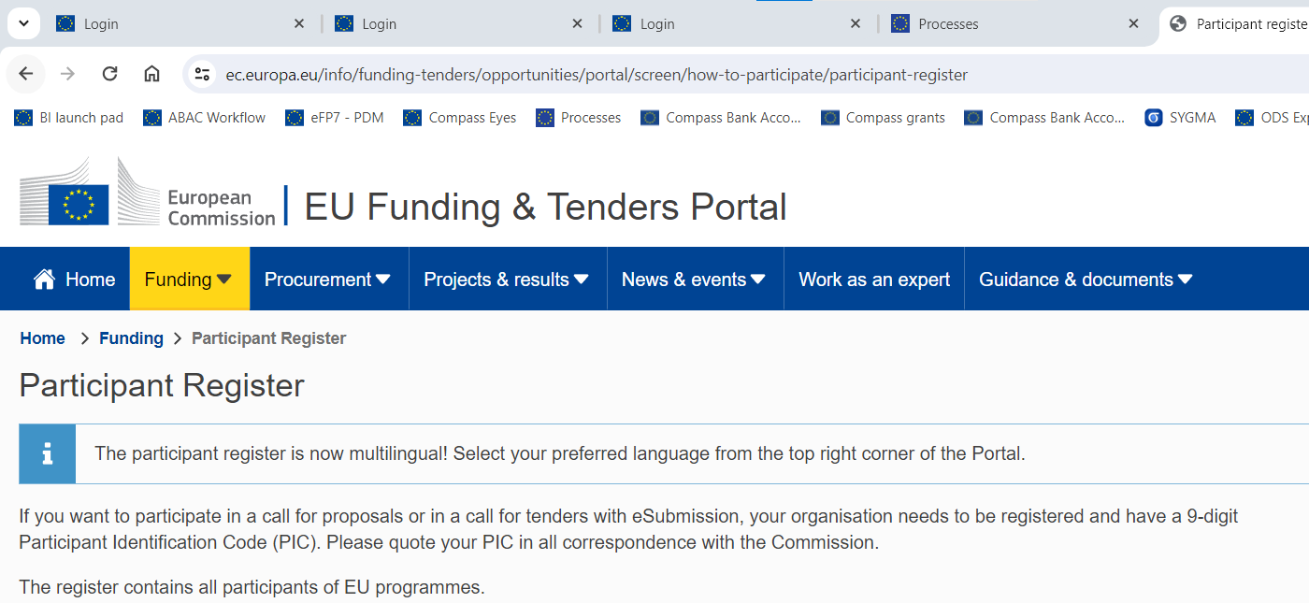
Registration of an organization (at proposal stage)

Slide 74
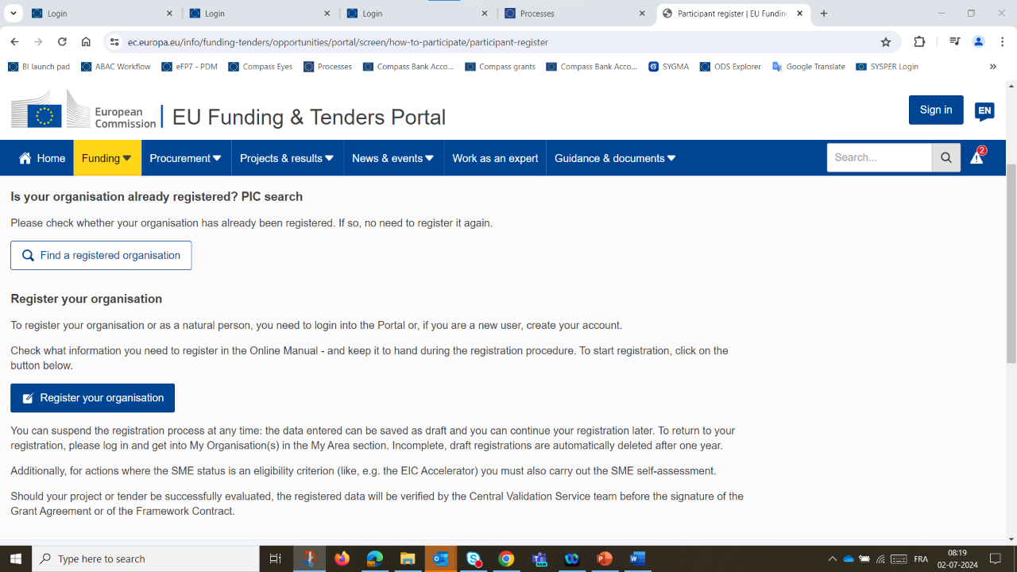
Registration of an organisation
(at proposal stage)
Search for a registered organisation
New registration

Slide 75
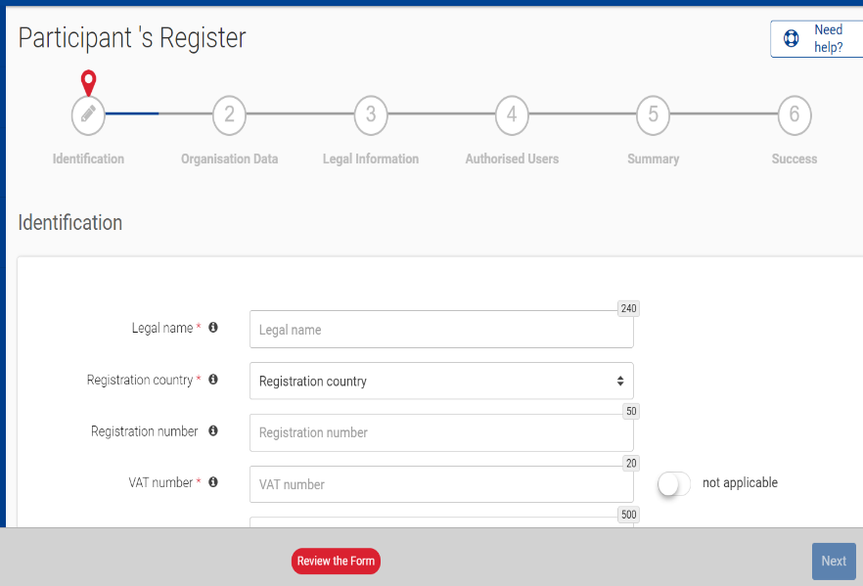
How to register in the Participant Register
Identification
(e.g. Legal name, VAT number)
Organisation data
Legal information
Authorised users
Registration completed
(e.g. Name, e-mail address of the self-registrant and the back-up)
New Participant Identification Code (PIC) in a “declared” status

Slide 76

Validation Process Overview
Organisations have to register in the Participant Register
Financial Capacity Assessment if needed
Mandatory
Based upon
legal documents
Mandatory for all validated participants
COMMUNICATION VIA PARTICIPANT REGISTER

Slide 77
Legal validation
  Registration data is verified by REA Central Validation Service before the signature of the Grant Agreement or the Contract
  The legal validation of a participant is done once, when the entity has to sign its first Grant Agreement or Contract and it is reused for future participations in EU grant and procurement actions
  Validation is always performed on the basis of supporting documents, in accordance to EU Financial Regulation and the Rules on Legal Entity Validation, LEAR Appointment and Financial Capacity Assessment for EU Grants and Tenders

Slide 78
Legal validation documents
Legal entity form (template to be completed, dated, stamped and signed)
VAT extract (< 1 year)
  If not registered for VAT – proof of VAT exemption
Registration extract (< 1 year) – for private law bodies
Law/decree/decision – for public law bodies
Treaty – for international organisations
Statutes – for non-profit organisations

Slide 79
Validation Process Overview
Organisations have to register in the Participant Register
Financial Capacity Assessment if needed
Mandatory for all validated participants
Based upon
legal documents
Mandatory
COMMUNICATION VIA PARTICIPANT REGISTER

Slide 80

LEAR role and duties
  In the Single Electronic Data Interchange Area, the appointment of the Legal Entity Appointed Representative (LEAR) is mandatory.
  The LEAR:
    Notifies the EU of changes in legal data/status
    Submits legal and financial documents if required
    Manages access rights of persons in the organisation (but not at the project level)
    Nominates 'Account Administrators' and individuals authorised to sign:
Contracts/grant agreements and their amendments (Legal signatories, i.e. LSIGN)
Financial statements (Financial signatories, i.e. FSIGN)

Slide 81
LEAR appointment documents
  LEAR appointment letter (duly signed by both the legal representative and the LEAR)
  Official proof of identity (ID-card/passport with photo and signature) of the legal representative and the LEAR
  Proof of empowerment of the legal representative
  Scanned version of these documents shall be uploaded in the Participant Register. Original of the LEAR appointment letter (1) must be kept in the entity's premises.

Slide 82

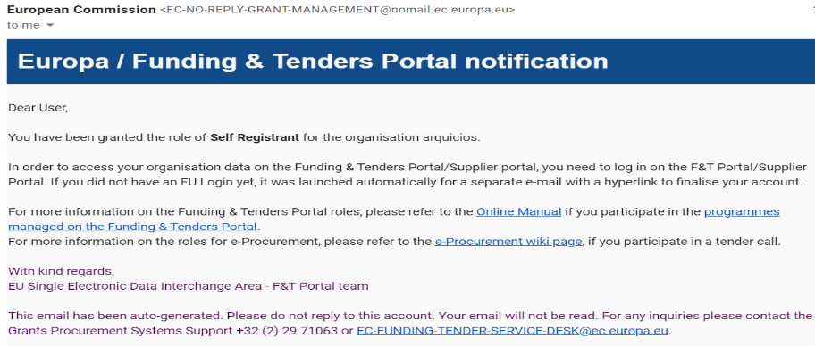
Communication
  Messages are notified via e-mail to the contact person
  (i.e. self-registrant or the appointed LEAR)
  All communication is exclusively managed through the Participant Register

Slide 83

Access lost to a declared or valid PIC
Declared PIC
In case the self-registrant left the organisation and no one has access to a declared PIC – a new PIC needs to be created and REA CVS informed
Valid PIC
If the LEAR is not available anymore and there are no Account Administrators, a new LEAR needs to be appointed – LEAR recovery procedure
https://ec.europa.eu/research/participants/urf/lear-recovery/request/

Slide 84
Guidance documents
Rules on Legal validation, LEAR appointment and financial capacity assessment:
https://ec.europa.eu/info/funding-tenders/opportunities/docs/2021-2027/common/guidance/rules-lev-lear-fca_en.pdf
How to register in the Participant Register:
https://webgate.ec.europa.eu/funding-tenders-opportunities/display/OM/Online+Manual
Online Manual, IT How to, IT and RES Helpdesk and specific FAQs on the Funding and Tenders Portal:
https://ec.europa.eu/info/funding-tenders/opportunities/portal/screen/support/support
Legal notice on the Funding and Tenders Portal (terms and conditions, data protection):
https://ec.europa.eu/info/funding-tenders/opportunities/portal/screen/support/legalnotice

Slide 85

Research Enquiry Service
For questions about EU research funding programmes,
you can contact the Research Enquiry Service via the webform:
Research Enquiry Service (europa.eu)

Slide 86
Thank you!
Got questions? Contact as at
EISMEA-EU-ECOSYSTEMS@ec.europa.eu
European Innovation Ecosystems website
Women TechEU - European Commission website
#EUInnovationEcosytems @EU_EISMEA
#WomenTechEU
for European Innovation Ecosystems
for Women TechEU

